Slide 1
Project Performance Domains
SE423: Software Project Management

Slide 2
Outline
Project Performance Domains

Slide 3
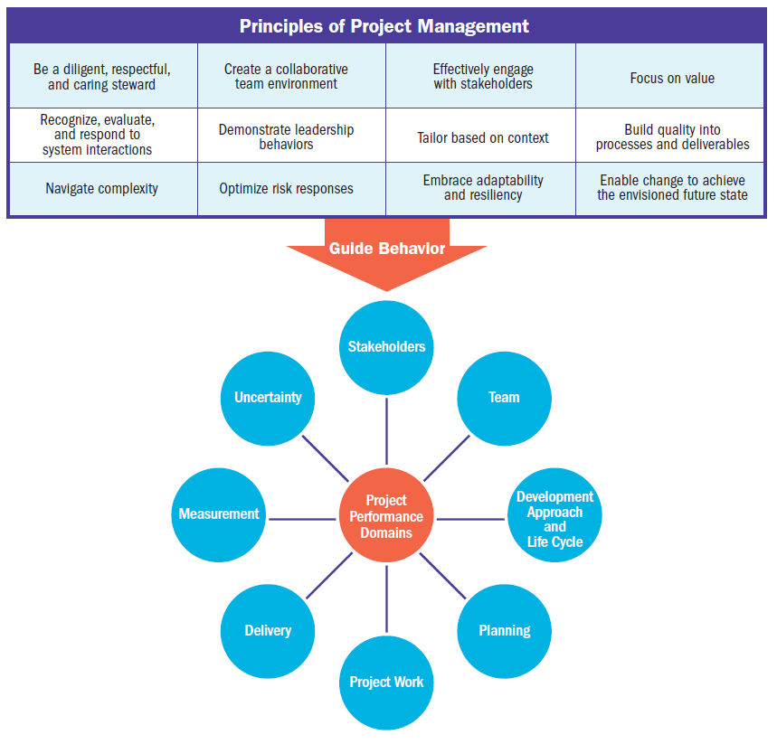

Slide 4
Project Performance Domains

Slide 5
Project Performance Domains
A project performance domain is a group of related activities that are critical for the effective delivery of project outcomes.
Project performance domains are interactive, interrelated, and interdependent areas of focus that work in unison to achieve desired project outcomes.

Slide 6
Project Performance Domains
There are eight project performance domains:
Stakeholders,
Team,
Development Approach and Life Cycle,
Planning,
Project Work,
Delivery,
Measurement, and
Uncertainty.

Slide 7
Project Performance Domains
The performance domains operate as an integrated system, with each performance domain being interdependent of the other performance domains to enable successful delivery of the project and its intended outcomes.
Performance domains run concurrently throughout the project, regardless of how value is delivered (frequently, periodically, or at the end of the project).

Slide 8
Project Performance Domains
For example, project leads spend time focused on stakeholders, the project team, the project life cycle, the project work, and so forth, from the outset of the project to its closure.
These areas of focus are not addressed as siloed efforts because they overlap and interconnect.
The ways in which the performance domains relate are different for each project, but they are present in every project.

Slide 9
Stakeholder Performance Domain

Slide 10
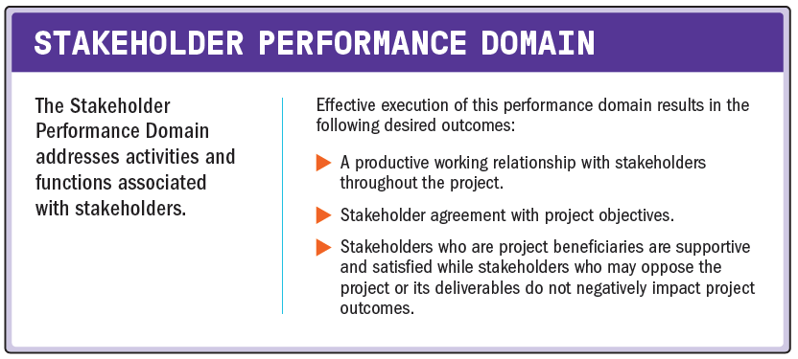
Stakeholder Performance Domain

Slide 11
Stakeholder Performance Domain
The following definitions are relevant to the Stakeholder Performance Domain:
Stakeholder
An individual, group, or organization that may affect, be affected by, or perceive itself to be affected by a decision, activity, or outcome of a project, program, or portfolio.
Stakeholder Analysis
A method of systematically gathering and analyzing quantitative and qualitative information to determine whose interests should be taken into account throughout the project.

Slide 12
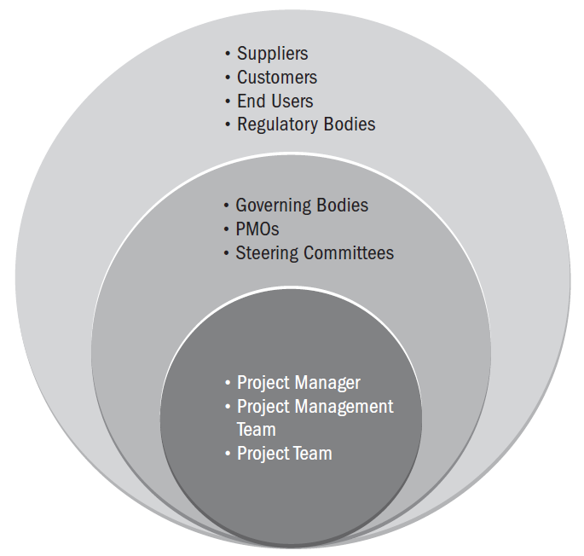
Examples of Project Stakeholders

Slide 13
Stakeholder Performance Domain
Effective stakeholder identification, analysis, and engagement includes stakeholders who are internal and external to the organization, those who are supportive of the project, and those who may not be supportive or are neutral.
While having relevant technical project management skills is an important aspect of successful projects, having the interpersonal and leadership skills to work effectively with stakeholders is just as important, if not more so.

Slide 14
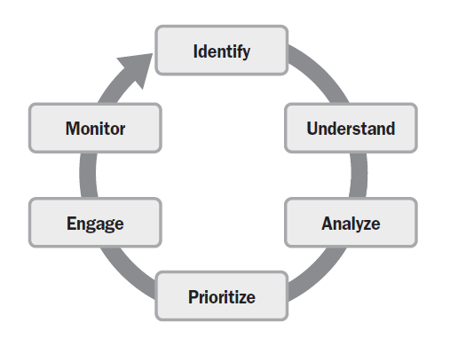
Stakeholder Engagement

Slide 15
Stakeholder Engagement
Identify
High-level stakeholder identification may be carried out prior to forming the project team.
Detailed stakeholder identification progressively elaborates the initial work and is a continuous activity throughout the project.
Some stakeholders are easy to identify, such as the customer, sponsor, project team, end users, and so forth, but others can be difficult to identify when they are not directly connected to the project.

Slide 16
Stakeholder Engagement
Understand and Analyze
Once stakeholders are identified, the project manager and the project team should seek to understand stakeholders’ feelings, emotions, beliefs, and values.
These elements can lead to additional threats or opportunities for the project outcomes.
They can also change quickly, and as such, understanding and analyzing stakeholders is an ongoing action.
Related to understanding the project stakeholders is the need to analyze aspects of each stakeholder’s position on and perspective of the project.

Slide 17
Stakeholder Engagement
Understand and Analyze
Analyzing stakeholders considers several stakeholder aspects, such as:
Power,
Impact,
Attitude,
Beliefs,
Expectations,
Degree of influence,
Proximity to the project,
Interest in the project, and
Other aspects surrounding stakeholder interaction with the project.

Slide 18
Stakeholder Engagement
Understand and Analyze
This information helps the project team consider interactions that may influence the motivations, actions, and behaviors of stakeholders.
In addition to individual analysis, the project team should consider how stakeholders interact with each other, as they often form alliances that help or hinder the project’s objectives.
For example, if the project team believes a key business manager is highly influential but has negative perceptions related to the project, they can explore how to detect the business manager’s perceptions and respond appropriately as the project unfolds.
In all cases, the analysis work should be held in confidence by the project team since the information could be misinterpreted outside the context for the analysis.

Slide 19
Stakeholder Engagement
Prioritize
On many projects, there are too many stakeholders involved for the project team to engage directly or effectively with all of them.
Based on its analysis, the project team can complete an initial prioritization of stakeholders.
It is common to focus on stakeholders with the most power and interest as one way to prioritize engagement.
As events unfold throughout the project, the project team may need to reprioritize based on new stakeholders or evolving changes in the stakeholder landscape.

Slide 20
Stakeholder Engagement
Engage
Stakeholder engagement entails working collaboratively with stakeholders to introduce the project, elicit their requirements, manage expectations, resolve issues, negotiate, prioritize, problem solve, and make decisions.
Engaging stakeholders requires the application of soft skills, such as active listening, interpersonal skills, and conflict management, as well as leadership skills such as establishing the vision and critical thinking.

Slide 21
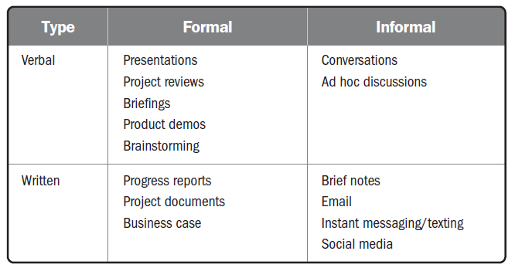
Stakeholder Engagement
Engage

Slide 22
Stakeholder Engagement
Engage
Communication methods include push, pull, and interactive communication:
Push.
Sent to stakeholders such as memos, emails, status reports, voice mail, and so forth.
One-way communications with individual stakeholders or groups of stakeholders.
Inhibits the ability to immediately gauge reaction and assess understanding; therefore, it should be used deliberately.
Pull.
Information sought by the stakeholder, such as a project team member going to an intranet to find communication policies or templates, running internet searches, and using online repositories.
Pulling information is used for indirect sensing of stakeholder concerns.

Slide 23
Stakeholder Engagement
Engage
With all forms of communication, quick feedback loops provide useful information to:
Confirm the degree to which the stakeholder(s) heard the message.
Determine if stakeholders agree with the message.
Identify nuanced or other unintended messages the recipient detected.
Gain other helpful insights.

Slide 24
Stakeholder Engagement
Monitor
Throughout the project, stakeholders will change as new stakeholders are identified and others cease to be stakeholders.
As the project progresses, the attitude or power of some stakeholders may change.
In addition to identifying and analyzing new stakeholders, there is an opportunity to assess whether the current engagement strategy is effective or if it needs to be adjusted.
Therefore, the amount and effectiveness of stakeholder engagement is monitored throughout the project.

Slide 25
Stakeholder Engagement
Monitor
The degree of stakeholder satisfaction can often be determined by having a conversation with stakeholders to gauge their satisfaction with the project deliverables and the overall management of the project.
Project and iteration reviews, product reviews, stage gates, and other methods are ways to obtain periodic feedback.
For large groups of stakeholders, a survey can be used to assess the degree of satisfaction.
Where necessary, the stakeholder engagement approach can be updated to achieve higher stakeholder satisfaction.

Slide 26
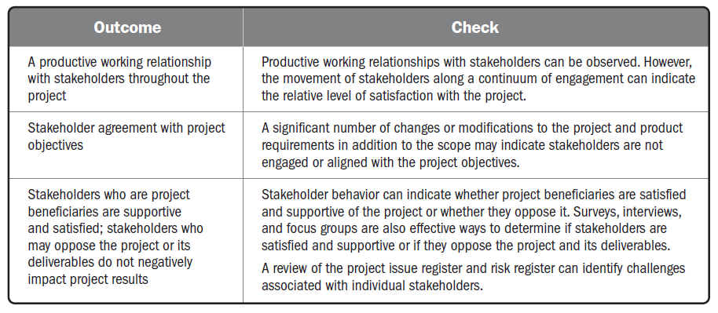
Checking Outcomes—Stakeholder Performance Domain

Slide 27
Team Performance Domain

Slide 28
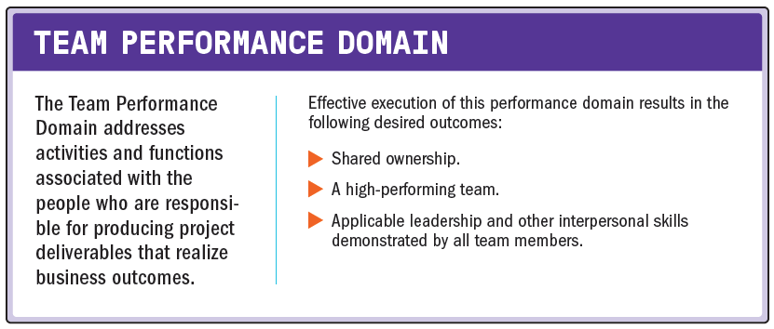
Team Performance Domain

Slide 29
Team Performance Domain
The following definitions are relevant to the Team Performance Domain:
Project Manager
The person assigned by the performing organization to lead the project team that is responsible for achieving the project objectives.
Project Management Team
The members of the project team who are directly involved in project management activities.
Project Team
A set of individuals performing the work of the project to achieve its objectives.

Slide 30
Project Team Management and Leadership
Project management entails applying knowledge, skills, tools, and techniques for management activities as well as leadership activities.
Management activities focus on the means of meeting project objectives, such as having effective processes, planning, coordinating, measuring, and monitoring work, among others. Leadership activities focus on people.
Leadership includes influencing, motivating, listening, enabling, and other activities having to do with the project team.
Both are important in delivering the intended outcomes.

Slide 31
Project Team Management and Leadership
Centralized Management and Leadership
While leadership activities should be practiced by all project team members, management activities may be centralized or distributed.
In an environment where management activities are centralized, accountability (being answerable for an outcome), is usually assigned to one individual, such as the project manager or similar role.
In these situations, a project charter or other authorizing document can provide approval for the project manager to form a project team to achieve the project outcomes.

Slide 32
Project Team Management and Leadership
Distributed Management and Leadership
Sometimes project management activities are shared among a project management team, and project team members are responsible for completing the work.
There are also situations where a project team may self-organize to complete a project.
Rather than having a designated project manager, someone within the project team may serve as facilitator to enable communication, collaboration, and engagement.
This role may shift among project team members.

Slide 33
Project Team Management and Leadership
Distributed Management and Leadership
Servant leadership is a style of leadership that focuses on understanding and addressing the needs and development of project team members in order to enable the highest possible project team performance.
Servant leaders place emphasis on developing project team members to their highest potential by focusing on addressing questions, such as:
Are project team members growing as individuals?
Are project team members becoming healthier, wiser, freer, and more autonomous?
Are project team members more likely to become servant leaders?

Slide 34
Project Team Management and Leadership
Distributed Management and Leadership
Servant leaders allow project teams to self-organize when possible and increase levels of autonomy by passing appropriate decision-making opportunities to project team members.
Servant leadership behaviors include:
Obstacle removal
Diversion shield
Encouragement and development opportunities

Slide 35
Project Team Management and Leadership
Common Aspects of Team Development
Regardless of how the management activities are structured, there are common aspects of project team development that are relevant for most project teams.
These include:
Vision and objectives.
It is essential that everyone is aware of the project vision and objectives.
The vision and objectives are communicated throughout the project.
This includes referencing the intended outcomes when the project team is engaged in making decisions and solving problems.

Slide 36
Project Team Management and Leadership
Common Aspects of Team Development
Regardless of how the management activities are structured, there are common aspects of project team development that are relevant for most project teams.
These include:
Roles and responsibilities.
It is important to make sure project team members understand and fulfill their roles and responsibilities.
This can include identifying gaps in knowledge and skills as well as strategies to address those gaps through training, mentoring, or coaching.

Slide 37
Project Team Management and Leadership
Common Aspects of Team Development
Regardless of how the management activities are structured, there are common aspects of project team development that are relevant for most project teams.
These include:
Project team operations.
Facilitating project team communication, problem solving, and the process of coming to consensus may include working with the project team to develop a project team charter and a set of operating guidelines or project team norms.

Slide 38
Project Team Management and Leadership
Common Aspects of Team Development
Regardless of how the management activities are structured, there are common aspects of project team development that are relevant for most project teams.
These include:
Guidance.
Guidance can be directed to the overall project team to keep everyone headed in the right direction.
Individual project team members may also provide guidance on a particular task or deliverable.
Growth.
Identifying areas where the project team is performing well and pointing out areas where the project team can improve helps the project team to grow.
Working collaboratively, the project team can identify goals for its improvement and take steps to meet those goals.

Slide 39
Project Team Management and Leadership
Common Aspects of Team Development
When project teams form across different organizations based on a contract, strategic partnership, or other business relationship, specific roles that perform various functions may be more formalized and less flexible depending on the contract or other terms.
Such arrangements often require more up-front work to establish a “one team” mindset, ensure project team members understand how everyone contributes to the project, and establish other enablers that integrate skills, capabilities, and processes.

Slide 40
Project Team Culture
Each project team develops its own team culture.
The project team’s culture may be established deliberately by developing project team norms, or informally through the behaviors and actions of its project team members.
The project team culture operates within the organization’s culture but reflects the project team’s individual ways of working and interacting.

Slide 41
Project Team Culture
Human beings have a set of biases, some of them unconscious and some of them conscious.
For example, one person may feel that unless a schedule is displayed using a software-generated Gantt chart, that it is not a true or valid schedule.
Another person may have a contrasting bias that detailed planning any further out than 30 days is a waste of time.
Being open and transparent about biases up front establishes a culture of openness and trust that can enable consensus and collaboration.

Slide 42
Project Team Culture
The project manager is key in establishing and maintaining a safe, respectful, nonjudgmental environment that allows the project team to communicate openly.
One way to accomplish this is by modeling desired behaviors, such as:
Transparency
Integrity
Respect
Positive discourse
Support
Courage
Celebrating success

Slide 43
High-Performing Project Teams
The list below identifies some of the factors associated with high-performing project teams.
Open communication
Shared understanding
Shared ownership
Trust
Collaboration
Adaptability
Resilience
Empowerment
Recognition

Slide 44
Leadership Skills
Establishing and Maintaining Vision
Critical Thinking
Motivation
Interpersonal Skills

Slide 45
Leadership Skills
Establishing and Maintaining Vision
Every project has a purpose.
Understanding that purpose is critical for people to commit their time and energy in the right direction toward achieving the project purpose.
The project vision summarizes the project’s purpose clearly and succinctly. It describes a realistic, attractive view of the future project outcomes.
The vision is a powerful motivational tool.
It is a way to create passion and meaning for a project’s envisioned goal.

Slide 46
Leadership Skills
Establishing and Maintaining Vision
A good vision is clear, concise, and actionable.
It does the following:
Summarizes the project with a powerful phrase or short description,
Describes the best achievable outcome,
Creates a common, cohesive picture in project team members’ minds, and
Inspires passion for the outcome..

Slide 47
Leadership Skills
Critical Thinking
Throughout the various project performance domains, there is a need to recognize bias, identify the root cause of problems, and consider challenging issues, such as ambiguity, complexity, and so forth.
Critical thinking helps to accomplish these activities.
Critical thinking includes disciplined, rational, logical, evidence-based thinking. It requires an open mind and the ability to analyze objectively.
Critical thinking, especially when applied to discovery, can include conceptual imagination, insight, and intuition.

Slide 48
Leadership Skills
Critical Thinking
It can also include reflective thinking and metacognition (thinking about thinking and being aware of one’s awareness).
Project team members apply critical thinking to:
Research and gather unbiased, well-balanced information;
Recognize, analyze, and resolve problems;
Identify bias, unstated assumptions, and values;
Discern the use of language and the influence on oneself and others;
Analyze data and evidence to evaluate arguments and perspectives;
Observe events to identify patterns and relationships;
Apply inductive, deductive, and abductive reasoning appropriately; and
Identify and articulate false premises, false analogy, emotional appeals, and other faulty logic.

Slide 49
Leadership Skills
Motivation
Motivating project team members has two aspects:
the first is understanding what motivates project team members to perform, and
the second is working with project team members in such a way that they remain committed to the project and its outcomes.
Motivation to perform can be intrinsic or extrinsic.
Intrinsic motivation comes from inside the individual or is associated with the work. It is associated with finding pleasure in the work itself rather than focusing on rewards.
Extrinsic motivation is performing work because of an external reward such as a bonus. Much of the work done on projects is aligned with intrinsic motivation.

Slide 50
Leadership Skills
Motivation
Examples of intrinsic motivation factors include:
Achievement,
Challenge,
Belief in the work,
Making a difference,
Self-direction and autonomy,
Responsibility,
Personal growth,
Relatedness, and
Being part of a project team.

Slide 51
Leadership Skills
Motivation
People are not motivated by just one thing; however, most people have a dominant motivator.
To effectively motivate project team members, it is helpful to know each member’s dominant motivator.
For example, a project team member who is motivated by challenge will respond well to stretch goals and problems to solve.
A project team member who is motivated by relatedness will respond to being part of a dynamic working group.

Slide 52
Leadership Skills
Interpersonal Skills
Interpersonal skills that are used frequently in projects include:
Emotional intelligence
Decision making, and
Conflict resolution among others.

Slide 53
Leadership Skills
Interpersonal Skills
Emotional intelligence
Emotional intelligence is the ability to recognize our own emotions and those of others.
This information is used to guide thinking and behavior.
Recognition of personal feelings, empathy for the feelings of others, and the ability to act appropriately are the cornerstones for effective communication, collaboration, and leadership.

Slide 54
Leadership Skills
Interpersonal Skills
Emotional intelligence
Since projects are undertaken by people and for people, emotional intelligence—the ability to understand one’s self and effectively sustain working relationships with others—is critical in project team environments.
There are multiple models for defining and explaining emotional intelligence which converge on four key areas:
Self-awareness.
Self-management
Social awareness.
Social skill.

Slide 55
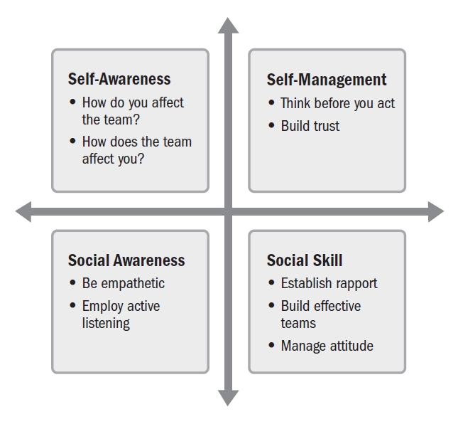
Components of Emotional Intelligence

Slide 56
Leadership Skills
Interpersonal Skills
Decision making
Project managers and project teams make many decisions daily.
Some decisions may be fairly inconsequential to the project outcome, such as where to go for a team lunch, and others will be very impactful, such as what development approach to use, which tool to use, or what vendor to select.
Decisions can be made unilaterally.
This has the advantage of being fast but is prone to error when compared to engaging the wisdom of a diverse set of people.
Unilateral decision making can also demotivate people who are impacted by the decision since they may feel their views and concerns were not considered.

Slide 57
Leadership Skills
Interpersonal Skills
Decision making
Group-based decision making has the benefit of tapping into the broad knowledge base of a group.
Engaging people in the decision-making process also increases buy-in to the outcome, even if the option selected may not have been everyone’s first choice.
Generally, inclusion increases commitment to the decision.
The downside of group decision making is the time required and interruption to teamwork that can occur when taking people away from their work to be consulted in a decision.

Slide 58
Leadership Skills
Interpersonal Skills
Decision making
Project team decision making often follows a diverge/converge pattern.
This means stakeholders are first engaged to generate a broad set of solution alternatives or approaches.
This is often done individually to avoid the effect of senior or charismatic stakeholders unduly influencing other stakeholders.
Then, after a broad spectrum of decision alternatives have been generated, the project team converges on a preferred solution.
The goal is to make decisions quickly while engaging the diverse knowledge of a group in an inclusive and respectful manner.

Slide 59
Leadership Skills
Interpersonal Skills
Conflict management
Conflict happens on all projects.
Projects operate in dynamic environments and face many mutually exclusive constraints including budget, scope, schedule, and quality, which can lead to conflicts.
It is not uncommon to want to avoid conflict, but not all conflict is negative. How conflict is handled can either lead to more conflict or to better decision making and stronger solutions.

Slide 60
Leadership Skills
Interpersonal Skills
Conflict management
Addressing conflict before it escalates beyond useful debate leads to better outcomes.
The following approaches can help:
Keep communications open and respectful.
Focus on the issues, not the people.
Focus on the present and future, not the past.
Search for alternatives together.

Slide 61
Tailoring Leadership Styles
leadership styles are tailored to meet the needs of the project, the environment, and the stakeholders.
Some of the variables that influence tailoring of leadership styles include:
Experience with the type of project
Maturity of the project team members
Organizational governance structures
Distributed project teams

Slide 62
Team Performance Domain
The Team Performance Domain emphasizes the skills used by project managers and project team members throughout the project.
These skills are woven into all other aspects of the project.
Project team members are called on to demonstrate leadership qualities and skills throughout the project.
Communicating the project vision and benefits to stakeholders while planning and throughout the life cycle is one example.
Another example is employing critical thinking, problem solving, and decision making while engaging in project work.
Accountability for outcomes is demonstrated throughout the Planning and Measurement Performance Domains.

Slide 63
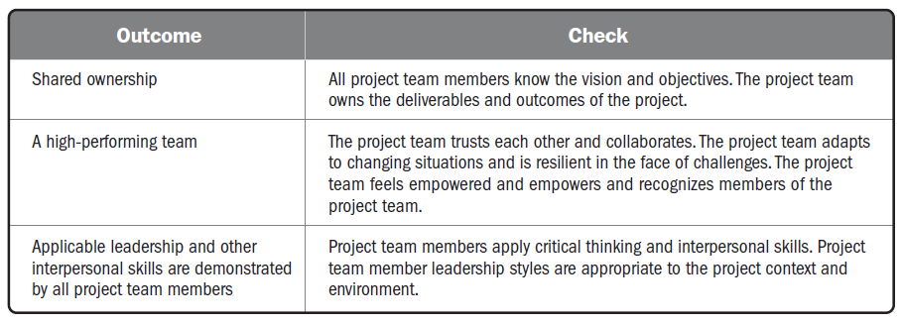
Checking Outcomes—Team Performance Domain

Slide 64
Development Approach and Life Cycle Performance Domain

Slide 65
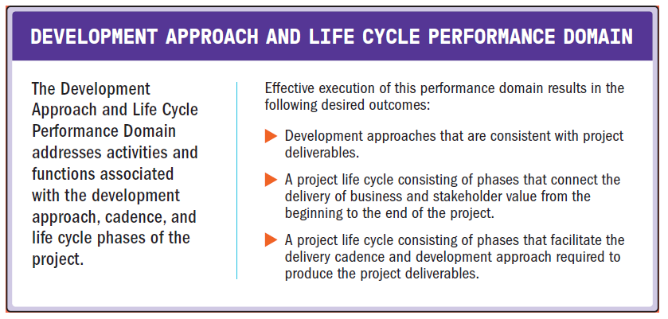
Development Approach and Life Cycle Performance Domain

Slide 66
Development Approach and Life Cycle Performance Domain
This performance domain entails establishing the development approach, delivery cadence, and project life cycle needed to optimize project outcomes.

Slide 67
Development Approach and Life Cycle Performance Domain
The following definitions are relevant to the Development Approach and Life Cycle Performance Domain:
Deliverable
Any unique and verifiable product, result, or capability to per form a service that is required to be produced to complete a process, phase, or project.
Development Approach.
A method used to create and evolve the product, service, or result during the project life cycle, such as a predictive, iterative, incremental, adaptive, or hybrid method.
Cadence.
A rhythm of activities conducted throughout the project.
Project Phase.
A collection of logically related project activities that culminates in the completion of one or more deliverables.
Project Life Cycle.
The series of phases that a project passes through from its start to its completion.

Slide 68
Development, Cadence, and Life Cycle
The type of project deliverable(s) determines how it can be developed.
The type of deliverable(s) and the development approach influence the number and cadence for project deliveries.
The deliverable approach and the desired delivery cadence determine the project life cycle and its phases.

Slide 69
Delivery Cadence
Delivery cadence refers to the timing and frequency of project deliverables.
Projects can have a single delivery, multiple deliveries, or periodic deliveries.

Slide 70
Delivery Cadence
Single delivery.
Projects that have a single delivery deliver at the end of the project.
For example, a process reengineering project may not have any deliveries until near the end of the project when the new process is rolled out.

Slide 71
Delivery Cadence
Multiple deliveries.
Some projects have multiple deliveries.
Multiple components that are delivered at different times throughout the project.
A project to develop a new drug may have multiple deliveries, such as preclinical submissions, Phase 1 trial results, Phase 2 trial results, Phase 3 trial results, registration, and then launch. In this example, the deliveries are sequential.
Some projects have deliveries that are developed separately rather than sequentially, such as a project to update building security.
Deliveries may include physical barriers to entry, new badges, new key code pads, and so forth.
Each of these is a separate delivery, but they do not need to come in a specific order.
All of the deliveries are concluded before the project is considered to be completed.

Slide 72
Delivery Cadence
Periodic deliveries.
Periodic deliveries are like multiple deliveries, but they are on a fixed delivery schedule, such as monthly or bimonthly.
A new software application may have internal deliveries every two weeks, and then periodically release the deliveries into the market.

Slide 73
Delivery Cadence
Another delivery option is called continuous delivery.
Continuous delivery is the practice of delivering feature increments immediately to customers, often through the use of small batches of work and automation technology.
Continuous delivery can be used for digital products.
From the product management perspective, the emphasis is on delivering benefits and value throughout the product life cycle.
Similar to a project, there are aspects that are development oriented. However, similar to a program, there can be many development cycles as well as maintenance activities.

Slide 74
Delivery Cadence
This type of undertaking works better with project teams that are stable and remain intact.
Because the project teams are focused on one product, they can apply learning about the product, the stakeholders, and the market.
This allows the team to respond to market trends and stay focused on value delivery.
This practice is included in several approaches such as DevOps, #noprojects and Continuous Digital, for example.

Slide 75
Development Approaches
A development approach is the means used to create and evolve the product, service, or result during the project life cycle.
There are different development approaches, and different industries may use different terms to refer to development approaches.
Three commonly used approaches are
predictive,
hybrid, and
adaptive.

Slide 76
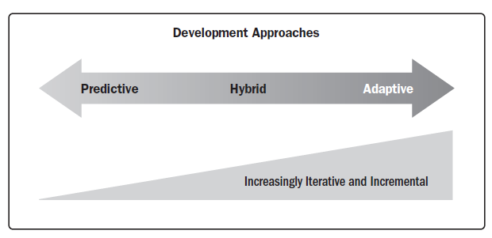
Development Approaches

Slide 77
Development Approaches
Predictive approach
A predictive approach is useful when the project and product requirements can be defined, collected, and analyzed at the start of the project. (Waterfall approach)
May also be used when there is a significant investment involved and a high level of risk that may require frequent reviews, change control mechanisms, and replanning between development phases.

Slide 78
Development Approaches
Predictive approach
The scope, schedule, cost, resource needs, and risks can be well defined in the early phases of the project life cycle, and they are relatively stable.
This development approach allows the project team to reduce the level of uncertainty early in the project and do much of the planning up front.
Predictive approaches may use proof-of-concept developments to explore options, but the majority of the project work follows the plans that were developed near the start of the project. Many times, projects that use this approach have templates from previous, similar projects.

Slide 79
Development Approaches
Hybrid approach
A hybrid development approach is a combination of adaptive and predictive approaches.
This means that some elements from a predictive approach are used and some from an adaptive approach are used.
This development approach is useful when there is uncertainty or risk around the requirements.
Hybrid is also useful when deliverables can be modularized, or when there are deliverables that can be developed by different project teams.

Slide 80
Development Approaches
Hybrid approach
A hybrid approach is more adaptive than a predictive approach, but less so than a purely adaptive approach.
Hybrid approaches often use an iterative or incremental development approach.
An iterative approach is useful for clarifying requirements and investigating various options.
An iterative approach may produce sufficient capability to be considered acceptable prior to the final iteration.
An incremental approach is used to produce a deliverable throughout a series of iterations.
Each iteration adds functionality within a predetermined time frame (a timebox).
The deliverable contains the capability to be considered as completed only after the final iteration.

Slide 81
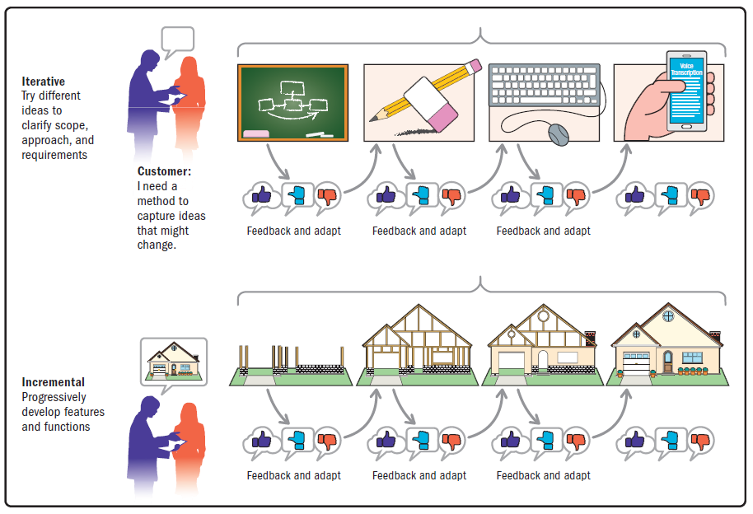
Development Approaches
Hybrid approach

Slide 82
Development Approaches
Adaptive approach
Adaptive approaches are useful when requirements are subject to a high level of uncertainty and volatility and are likely to change throughout the project.
A clear vision is established at the start of the project, and the initial known requirements are refined, detailed, changed, or replaced in accordance with user feedback, the environment, or unexpected events.
Adaptive approaches use iterative and incremental approaches. However, on the far side of the adaptive methods, the iterations tend to get shorter and the product is more likely to evolve based on stakeholder feedback.

Slide 83
Development Approaches
Adaptive approach
While agility is a wide mindset that is broader than a development framework, agile approaches can be considered adaptive. Some agile approaches entail iterations that are 1 to 2 weeks in duration with a demonstration of the accomplishments at the end of each iteration.
The project team is very engaged with the planning for each iteration.
The project team will determine the scope they can achieve based on a prioritized backlog, estimate the work involved, and work collaboratively throughout the iteration to develop the scope.

Slide 84
Considerations for Selecting Approaches
There are several factors that influence the selection of a development approach.
They can be divided into categories:
The product, service, or result;
The project; and
The organization.

Slide 85
Considerations for Selecting Approaches
The product, service, or result;
There are many variables associated with the nature of the product, service, or result that influence the development approach.
Degree of innovation.
Deliverables where the scope and requirements are well understood, that the project team has worked with before, and that allow for planning up front are well suited to a predictive approach.
Deliverables that have a high degree of innovation or where the project team does not have experience are better suited to a more adaptive approach.
Requirements certainty.
When the requirements are well known and easy to define, a predictive approach fits well.
When requirements are uncertain, volatile, or complex and are expected to evolve throughout the project, a more adaptive approach may be a better fit.

Slide 86
Considerations for Selecting Approaches
The product, service, or result;
There are many variables associated with the nature of the product, service, or result that influence the development approach.
Scope stability.
If the scope of the deliverable is stable and not likely to change, a predictive approach is useful.
If the scope is expected to have many changes, an approach that is closer to the adaptive side of the spectrum can be useful.
Ease of change.
Related to the requirements certainty and the scope stability, if the nature of the deliverable makes it difficult to manage and incorporate changes, then a predictive approach is best.
Deliverables that can adapt easily to change can use an approach that is more adaptive.

Slide 87
Considerations for Selecting Approaches
The product, service, or result;
There are many variables associated with the nature of the product, service, or result that influence the development approach.
Delivery options.
The nature of the deliverable and whether it can be delivered in components influences the development approach.
Products, services, or results that can be developed and/or delivered in pieces are aligned with incremental, iterative, or adaptive approaches.
Some large projects may be planned using a predictive approach, but there may be some pieces that can be developed and delivered incrementally.
Risk.
Products that are inherently high risk require analysis before choosing the development approach.
Some high-risk products may require significant up-front planning and rigorous processes to reduce threats.
Other products can reduce risk by building them modularly and adapting the design and development based on learning to take advantage of emerging opportunities or reduce the exposure to threats.

Slide 88
Considerations for Selecting Approaches
The product, service, or result;
There are many variables associated with the nature of the product, service, or result that influence the development approach.
Safety requirements.
Products that have rigorous safety requirements often use a predictive approach as there is a need for significant up-front planning to ensure that all the safety requirements are identified, planned for, created, integrated, and tested.
Regulations.
Environments that have significant regulatory oversight may need to use a predictive approach due to the required process, documentation, and demonstration needs.

Slide 89
Considerations for Selecting Approaches
The Project;
Project variables that influence the development approach are centered around stakeholders, schedule constraints, and funding availability.
Stakeholders.
Projects that use adaptive methods require significant stakeholder involvement throughout the process.
Certain stakeholders, such as the product owner, play a substantial role in establishing and prioritizing work.
Schedule constraints.
If there is a need to deliver something early, even if it is not a finished product, an iterative or adaptive approach is beneficial.
Funding availability.
Projects that work in an environment of funding uncertainty can benefit from an adaptive or iterative approach.
A minimum viable product can be released with less investment than an elaborate product.
This allows for market testing or market capture with minimum investment.

Slide 90
Considerations for Selecting Approaches
The Organization;
Organizational variables such as the structure, culture, capability, project team size, and location influence the development approach.
Organizational structure.
An organizational structure that has many levels, a rigid reporting structure, and substantial bureaucracy frequently uses a predictive approach.
Projects that use adaptive methods tend to have a flat structure and may operate with self-organizing project teams.

Slide 91
Considerations for Selecting Approaches
The Organization;
Organizational variables such as the structure, culture, capability, project team size, and location influence the development approach.
Culture.
A predictive approach fits better in an organization with a culture of managing and directing, where the work is planned out and progress is measured against baselines.
Adaptive approaches fit better within an organization that emphasizes project team self-management.

Slide 92
Considerations for Selecting Approaches
The Organization;
Organizational variables such as the structure, culture, capability, project team size, and location influence the development approach.
Organizational capability.
Transitioning from predictive development approaches to adaptive approaches and then to using agile methods is more than just stating that the organization will now be agile.
It entails shifting the mindset starting at the executive level throughout the organization. Organizational policies, ways of working, reporting structure, and attitude should all be aligned in order to employ adaptive methods successfully.

Slide 93
Considerations for Selecting Approaches
The Organization;
Organizational variables such as the structure, culture, capability, project team size, and location influence the development approach.
Project team size and location.
Adaptive approaches, especially agile methods, often work better with project teams of 7 ± 2. Adaptive approaches also favor project teams that are located in the same physical space.
Large project teams and project teams that are mostly virtual may do better by using an approach that is closer to the predictive side of the spectrum. However, there are approaches that seek to scale up the adaptive approaches to work with large and dispersed project teams.

Slide 94
Life Cycle and Phase Definition
The type and number of project phases in a project life cycle depend upon many variables, chief among them the delivery cadence and the development approach, as described previously.
Examples of phases in a life cycle include:
Feasibility.
Business case is valid and the organization has the capability to deliver the intended outcome.
Design.
Planning and analysis lead to the design of the project deliverable that will be developed.
Build.
Construction of the deliverable with integrated quality assurance activities is conducted.
Test.
Final quality review and inspection of deliverables are carried out before transition, go-live, or acceptance by the customer.
Deploy.
Project deliverables are put into use and transitional activities are completed.
Close.
The project is closed, project knowledge and artifacts are archived, project team members are released, and contracts are closed.

Slide 95
Life Cycle and Phase Definition
Project phases often have a phase gate review (also known as stage gate) to check that the desired outcomes or exit criteria for the phase have been achieved before proceeding to the next phase.
Exit criteria may tie to acceptance criteria for deliverables, contractual obligations, meeting specific performance targets, or other tangible measures.

Slide 96
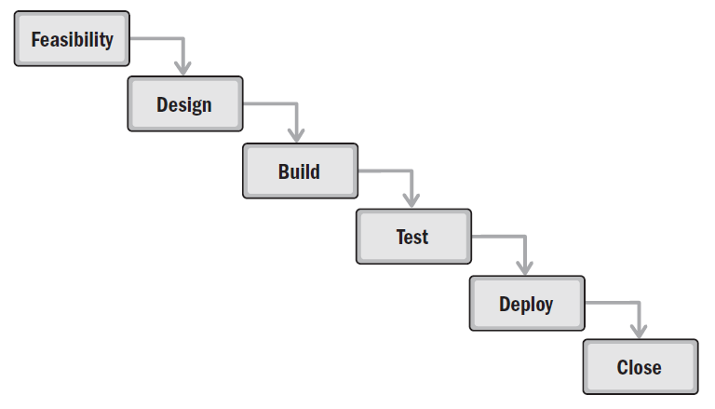
Sample Predictive Life Cycle

Slide 97
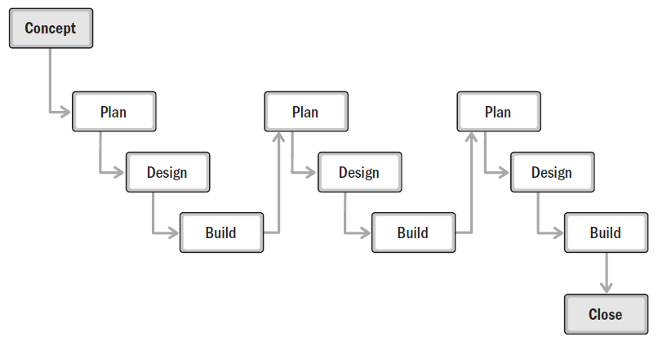
Sample Life Cycle with an Incremental Development Approach

Slide 98
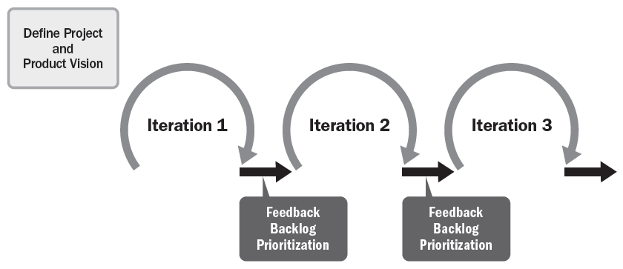
Life Cycle Using Adaptive Development Approach

Slide 99
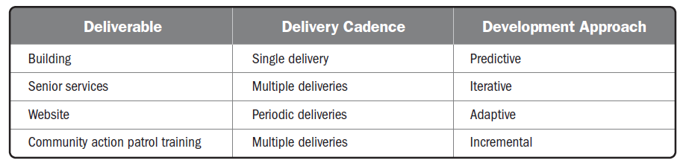
Delivery Cadence and Development Approach

Slide 100
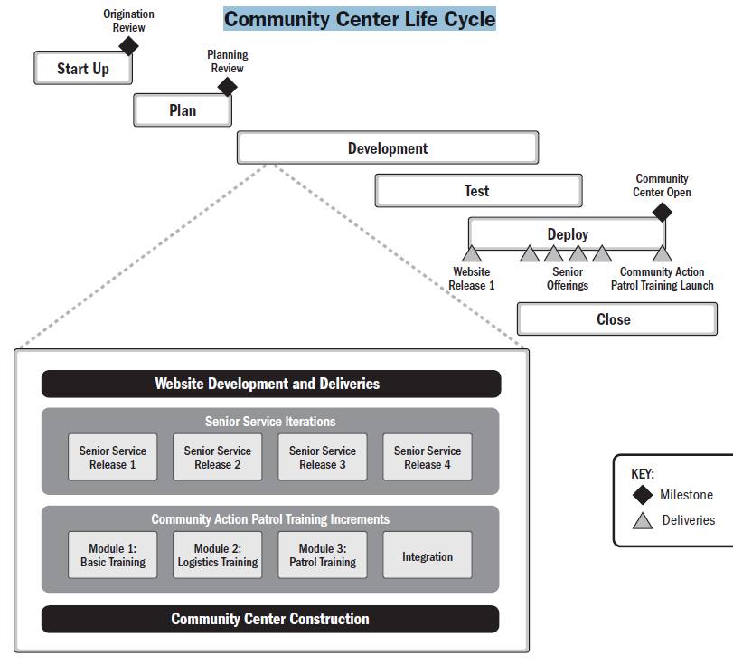

Slide 101
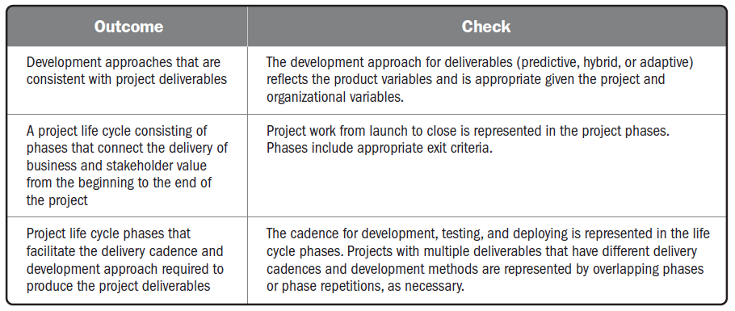
Checking Outcomes—Development Approach and Life Cycle Performance Domain

Slide 102
Planning Performance Domain

Slide 103
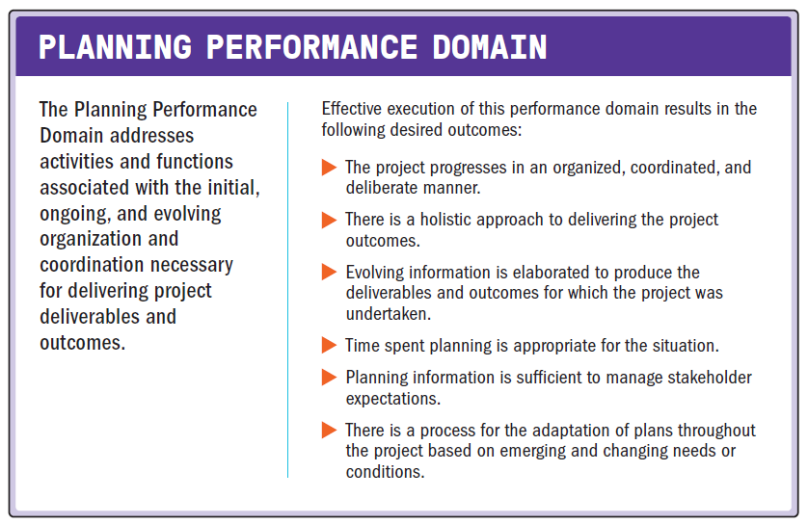
Planning Performance Domain

Slide 104
Planning Performance Domain
The following definitions are relevant to the Planning Performance Domain:
Estimate.
A quantitative assessment of the likely amount or outcome of a variable, such as project costs, resources, effort, or durations.
Accuracy.
Within the quality management system, accuracy is an assessment of correctness.
Precision.
Within the quality management system, precision is an assessment of exactness.

Slide 105
Planning Performance Domain
The following definitions are relevant to the Planning Performance Domain:
Crashing.
A method used to shorten the schedule duration for the least incremental cost by adding resources.
Fast Tracking.
A schedule compression method in which activities or phases normally done in sequence are performed in parallel for at least a portion of their duration.
Budget.
The approved estimate for the project or any work breakdown structure (WBS) component or any schedule activity.

Slide 106
Planning Overview
The purpose of planning is to proactively develop an approach to create the project deliverables.
The project deliverables drive the outcomes the project was undertaken to achieve.
High-level planning may begin prior to project authorization.
The project team progressively elaborates initial project documents, such as a vision statement, project charter, business case, or similar documents to identify or define a coordinated path to achieve the desired outcomes.

Slide 107
Planning Overview
It is becoming more common for initial planning to consider social and environmental impacts in addition to the financial impacts (sometimes referred to as t he triple bottom line).
This may take the form of a product life cycle assessment which evaluates the potential environmental impacts of a product, process, or system.
The product life cycle assessment informs the design of products and processes.
It considers the impacts of materials and processes with regards to sustainability, toxicity, and the environment.

Slide 108
Planning Overview
The amount of time spent planning, both up front and throughout the project, should be determined by the circumstances. It is inefficient to spend more time planning than is needed.
Therefore, the information gained from planning should be sufficient to move forward in an appropriate manner but not more detailed than necessary.
Project teams use planning artifacts to confirm stakeholder expectations and provide stakeholders with the information they need to make decisions, take action, and maintain alignment between the project and stakeholders.

Slide 109
Planning Variables
Variables that influence how project planning is conducted include, but are not limited to:
Development approach
Project deliverables
Organizational requirements
Market conditions
Legal or regulatory restrictions

Slide 110
Delivery
Planning begins with understanding the business case, stakeholder requirements, and the project and product scope.
Product scope is the features and functions that characterize a product, service, or result.
Project scope is the work performed to deliver a product, service, or result with the specified features and functions.

Slide 111
Delivery
Predictive planning approaches
start with the high-level project deliverables up front and decompose them into more detail.
Employ a scope statement and/or a work breakdown structure (WBS) to decompose the scope into lower levels of detail.
Iterative and Incremental planning
can have high-level themes or epics that are decomposed into features, which are then further decomposed into user stories and other backlog items.
Work that is unique, significant, risky, or novel can be prioritized to reduce the uncertainty associated with project scope at the start of the project before significant investment has taken place.
Project teams plan routine work based on the concept of last responsible moment.
This approach defers a decision to allow the project team to consider multiple options until the cost of further delay would exceed the benefit.
It reduces waste by not expending time in developing plans for work that may change or may not be needed.

Slide 112
Estimating
Planning entails developing estimates for work effort, duration, costs, people, and physical resources.
Estimates are a quantitative assessment of the likely amount or outcome of a variable, such as project costs, resources, effort, or duration.
As the project evolves, the estimates can change based on current information and circumstances.

Slide 113
Estimating
The project’s phase in the life cycle impacts four aspects associated with estimating:
Range
Accuracy
Precision
Confidence

Slide 114
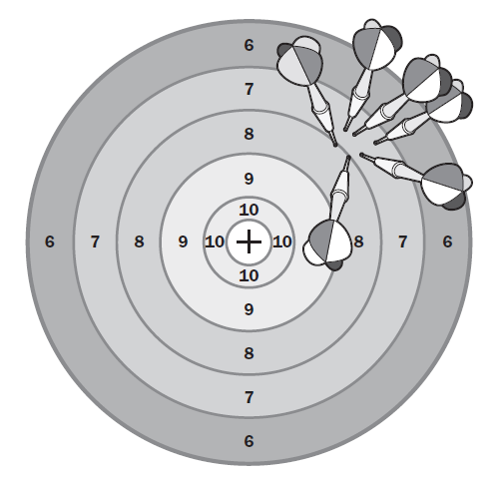
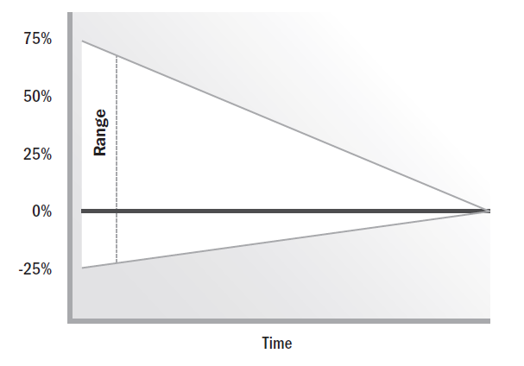
Estimating
Estimate Range Decreases over Time
Low Accuracy, High Precision

Slide 115
Estimating
There are different ways of presenting and/or adjusting estimates:
Deterministic and probabilistic estimating
Absolute and relative estimating
Flow-based estimating
Adjusting estimates for uncertainty
Notes:
Deterministic estimates are also known as point estimates and it presents a single number or amount such as 24 months. Probabilistic estimating include a range of estimates along with associated probabilities within the range.
Absolute estimates are specific information and use actual numbers – eg. 100 hours of work. Relative estimates are shown in comparison to other estimates. Relative estimates only have meaning within a given context.
Flow-based estimating provide an estimate to complete a specific quantity of work. The estimates are developed by determining the cycle time and throughput. Cycle time is the total elapsed time it takes one unit to get through a process. Throughput is the number of items that can complete a process in a given amount of time.
Estimates are inherently uncertain and therefore associated with risk. It is important to establish the range of uncertainty for various parameters.

Slide 116
Schedules
A schedule is a model for executing the project’s activities, including durations, dependencies, and other planning information.
Schedule planning can use predictive or adaptive approaches.
Predictive approaches follow a stepwise process as follows:
Step 1. Decompose the project scope into specific activities.
Step 2. Sequence related activities.
Step 3. Estimate the effort, duration, people, and physical resources required to complete the activities.
Step 4. Allocate people and resources to the activities based on availability.
Step 5. Adjust the sequence, estimates, and resources until an agreed-upon schedule is achieved.

Slide 117
Schedules
If the schedule model does not meet the initial desired end date, schedule compression methods are applied.
Crashing is a schedule compression method that seeks to shorten the duration for the least incremental cost.
Crashing can include adding people to activities, working overtime, or paying to expedite deliveries.

Slide 118
Schedules
Fast tracking is a schedule compression method in which activities or tasks that are normally done in sequence are performed in parallel, at least for a portion of their duration.
Fast tracking often entails applying leads and lags along a network path.
A lead is where the work of a successor activity is accelerated, such as starting a successor activity before the predecessor has finished.
A lag is a delay of a successor activity.
An example of using a lag would be changing the type of relationship between activities, and then applying a lag.
For example, rather than waiting for an activity to finish before the next one starts (a finish-to-start relationship), change the relationship to have the end of the successor activity finish a determined amount of time after the end of the predecessor (a finish-to-finish relationship).

Slide 119
Schedules
The network logic would show a lag between the finish of the predecessor and the finish of the successor activities.
A lag can also be applied between the start of one activity and the start of another activity (a start-to-start relationship).

Slide 120
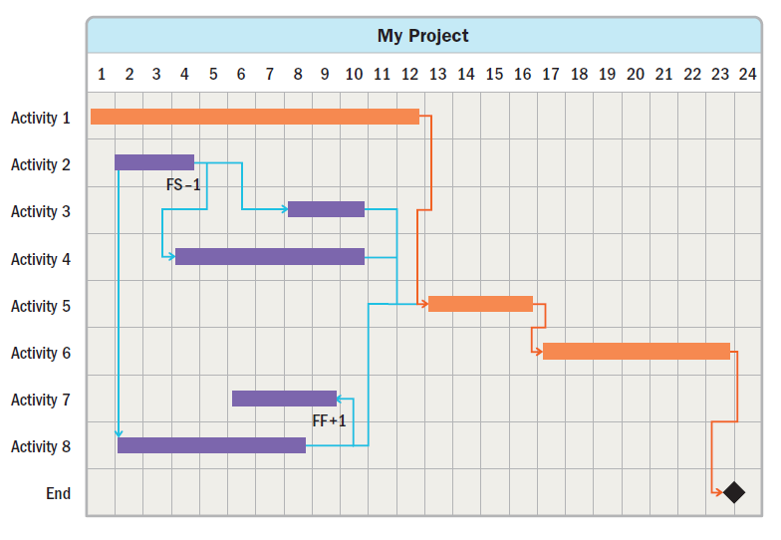
Schedules

Slide 121
Schedules
When compressing the schedule, it is important to determine the nature of the dependencies
between activities.
Some activities cannot be fast tracked due to the nature of the work—others can.

Slide 122
Schedules
The four types of dependencies are:
Mandatory dependency.
A relationship that is contractually required or inherent in the nature of the work. This type of dependency usually cannot be modified.
Discretionary dependency.
A relationship that is based on best practices or project preferences. This type of dependency may be modifiable.
External dependency.
A relationship between project activities and non-project activities. This type of dependency usually cannot be modified.
Internal dependency.
A relationship between one or more project activities. This type of dependency may be modifiable.

Slide 123
Schedules
Adaptive schedule planning uses incremental planning.
One such scheduling approach is based on iterations and releases.
A high-level release plan is developed that indicates the basic features and functionality to be included in each release.
Within each release, there will be two or more iterations.
Each iteration adds business and/or stakeholder value.
Value may include features, risk reduction, experimentation, or other ways of delivering or protecting value.
The planning for the work in future releases is kept at a high level so the project team does not engage in planning that could change based on feedback from earlier releases.

Slide 124
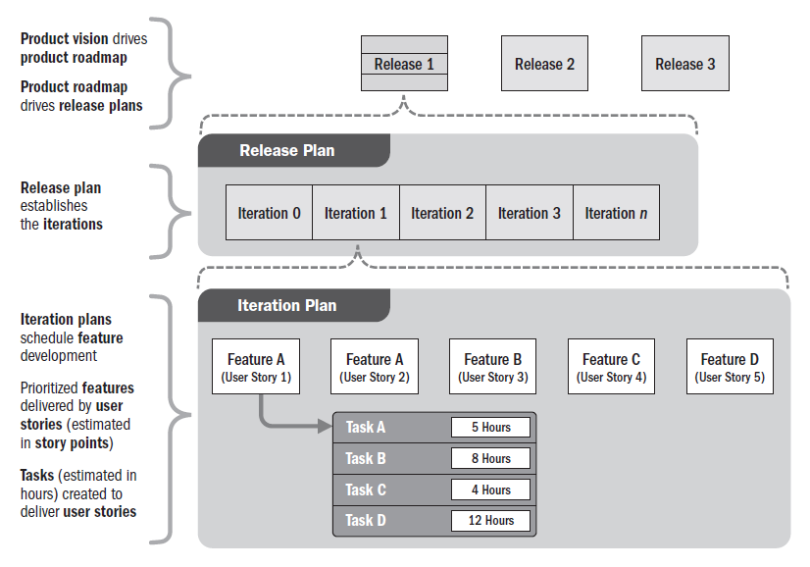
Schedules (Release and Iteration Plan)

Slide 125
Schedules
Adaptive approaches often use timeboxes.
The work in each timebox is based on a prioritized backlog.
The project team determines the amount of work they can do in each timebox, estimates the work, and self-manages to accomplish the work.
At the end of the timebox, the project team demonstrates the work completed.
At that point, the backlog and estimates of work available to be done may be updated or reprioritized for the next timebox.

Slide 126
Budget
The project budget evolves from the agreed estimates for the project.
Cost estimates are then aggregated to develop the cost baseline.
The cost baseline is often allocated across the project schedule to reflect when the costs will be incurred.
This practice allows project managers to balance the funds approved in a specific budget period with the scheduled work.
If there are funding limitations for a budget period, the work may need to be rescheduled to meet those limitations.

Slide 127
Budget
The project budget should include contingency reserve funds to allow for uncertainty.
Contingency reserves are set aside to implement a risk response or to respond to risk events should they occur.
Management reserves are set aside for unexpected activities related to in-scope work.
Depending on the organization’s policies and organizational structure, management reserves may be managed by the project, the sponsor, product owner, or the PMO at the program and portfolio level.

Slide 128
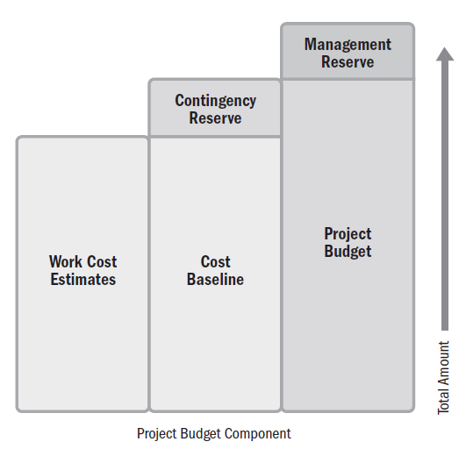
Budget Build Up

Slide 129
Project Team Composition and Structure
Planning for project team composition begins with identifying the skill sets required to accomplish the project work.
This entails evaluating not only the skills, but also the level of proficiency and years of experience in similar projects.
There are different cost structures associated with using internal project team members versus securing them from outside the organization.
The benefit that outside skills bring to the project are weighed against the costs that will be incurred.

Slide 130
Project Team Composition and Structure
When planning for the project team, the project manager considers the ability and necessity for the project team to work in the same location.
Small project teams that can work in the same room are able to take advantage of osmotic communication and can solve problems as they arise.
Some project teams are physically dispersed.
Project team members may be in different cities, time zones, or countries. On projects where project team members work virtually, more time is spent connecting people through technology.

Slide 131
Communication
Communication planning overlaps with stakeholder identification, analysis, prioritization, and engagement.
Communication is the most important factor in engaging with stakeholders effectively.

Slide 132
Communication
Planning communication for the project entails considering the following:
Who needs information?
What information does each stakeholder need?
Why should information be shared with stakeholders?
What is the best way to provide information?
When and how often is information needed?
Who has the information needed?
There may be different categories of information, such as internal and external, sensitive and public, or general and detailed.
Analyzing the stakeholders, information needs, and categories of information provides the foundation for establishing the communications processes and plans for the project.

Slide 133
Physical Resources
Physical resources apply to any resource that is not a person.
It can include materials, equipment, software, testing environments, licenses, and so forth.
Planning for physical resources entails estimating, as well as supply chain, logistics, and management.
Projects with significant physical resources, such as engineering and construction projects, will need to plan for procurement activities to acquire the resources.
This may be as simple as utilizing a basic ordering agreement or as complicated as managing, coordinating, and integrating several large procurement activities.

Slide 134
Physical Resources
Planning for physical resources includes taking into account lead time for delivery, movement, storage, and disposition of materials, as well as a means to track material inventory from arrival on site to delivery of an integrated product.
Project teams whose projects require significant physical materials think and plan strategically about the timing from order, to delivery, to usage.
This can include evaluation of bulk ordering versus cost of storage, global logistics, sustainability, and integrating management of physical assets with the rest of the project.

Slide 135
Procurement
Procurements can happen at any time during a project. However, up-front planning helps to set expectations that ensure the procurement process is performed smoothly.
Once the high-level scope is known, project teams conduct a make-or-buy analysis.
This includes identifying those deliverables and services that will be developed in-house, and those that will be purchased from external sources.
This information impacts the project team and the schedule.
Contracting professionals need advance information on the type of goods needed, when they will be needed, and any technical specifications required for the procured goods or services.

Slide 136
Changes
There will be changes throughout the project.
Some changes are a result of a risk event occurring or a project environment change, some are based on developing a deeper understanding of requirements, and others are due to customer requests or other reasons.
Therefore, project teams should prepare a process for adapting plans throughout the project.
This may take the form of a change control process, reprioritizing the backlog, or rebaselining the project.
Projects that have a contractual element may need to follow a defined process for contract changes.

Slide 137
Metrics
There is a natural linkage between planning, delivering, and measuring work.
That linkage is metrics.
Establishing metrics includes setting the thresholds that indicate whether work performance is as expected, trending positively or negatively away from expected performance, or unacceptable.
Deciding what to measure and how often is best informed by the phrase “only measure what matters.”

Slide 138
Metrics
Metrics associated with the product are specific to the deliverables being developed.
Metrics associated with schedule and budget performance are often driven by organizational standards and are related to a baseline or an approved version of the schedule or budget against which actual results are compared.
As part of planning, the metrics, baselines, and thresholds for performance are established, as well as any test and evaluation processes and procedures that will be used to measure performance to the specification of the project deliverable.
The metrics, baselines, and tests are used as the basis to evaluate variance of actual performance as part of the Measurement Performance Domain.

Slide 139
Alignment
Planning activities and artifacts need to remain integrated throughout the project.
This means that planning for the performance in terms of scope and quality requirements aligns with delivery commitments, allocated funds, type and availability of resources, the uncertainty inherent in the project, and stakeholder needs.
Project teams can require additional planning artifacts depending on the type of project.
For example, logistics plans will need to integrate with material and delivery needs, testing plans will need to align with quality and delivery needs, and so forth.

Slide 140
Alignment
Work on one project often occurs in parallel with other projects in a program or a release.
The timing of the work of a single project should align with the needs of the work on related projects and the operations work of the organization.
Large projects may combine the planning artifacts into an integrated project management plan.
For smaller projects, a detailed project management plan will be inefficient.
Regardless of the timing, frequency, and degree of planning, the various aspects of the project need to remain aligned and integrated.

Slide 141
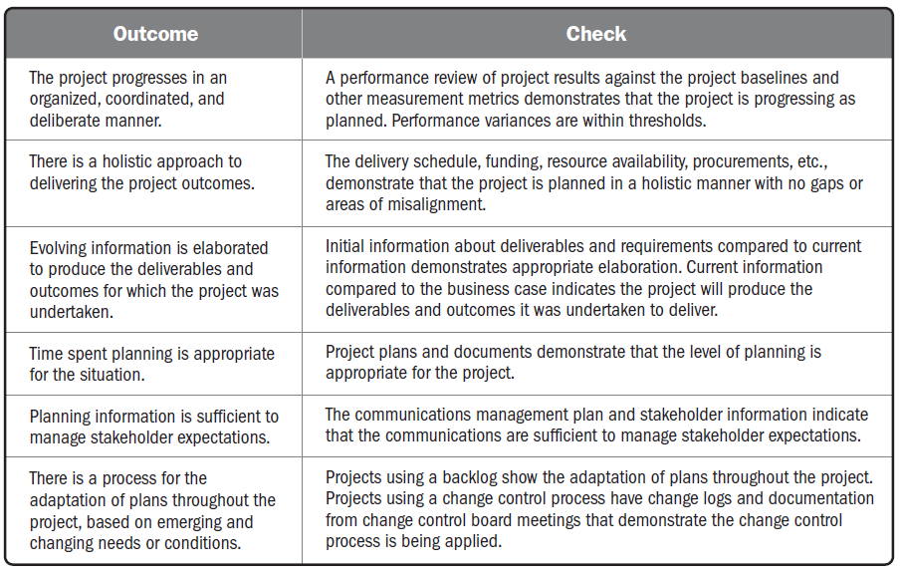
Checking Outcomes—Planning Performance Domain

Slide 142
Project Work Performance Domain

Slide 143
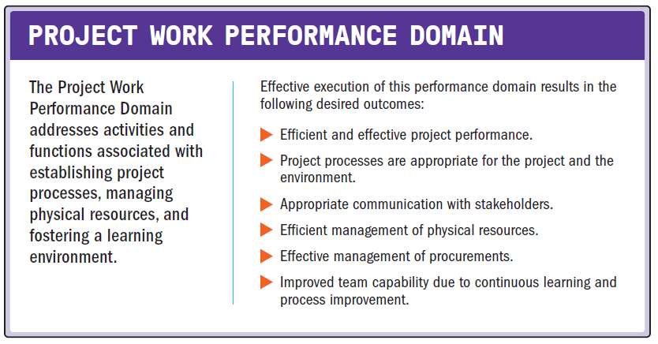
Project Work Performance Domain

Slide 144
Project Work Performance Domain
The following definitions are relevant to the Project Work Performance Domain:
Bid Documents.
All documents used to solicit information, quotations, or proposals from prospective sellers.
Bidder Conference.
The meetings with prospective sellers prior to the preparation of a bid or proposal to ensure all prospective vendors have a clear and common understanding of the procurement. Also known as contractor conferences, vendor conferences, or pre-bid conferences.
Explicit Knowledge.
Knowledge that can be codified using symbols such as words, numbers, and pictures.
Tacit Knowledge.
Personal knowledge that can be difficult to articulate and share such as beliefs, experience, and insights.

Slide 145
Project Work Performance Domain
Project work keeps the project team focused and project activities running smoothly.
This includes but is not limited to:
Managing the flow of existing work, new work, and changes to work;
Keeping the project team focused;
Establishing efficient project systems and processes;
Communicating with stakeholders;
Managing material, equipment, supplies, and logistics;
Working with contracting professionals and vendors to plan and manage procurements and contracts;
Monitoring changes that can affect the project; and
Enabling project learning and knowledge transfer.

Slide 146
Project Processes
The project manager and the project team establish and periodically review the processes the project team is using to conduct the work.
This can take the form of reviewing task boards to determine if there are bottlenecks in the process, if work is flowing at the expected rate, and if there are any impediments that are blocking progress.

Slide 147
Project Processes
Process tailoring can be used to optimize the process for the needs of the project.
In general, large projects have more process compared to small projects, and critical projects have more process than less significant projects.
Tailoring takes into consideration the demands of the environment.
Ways of optimizing the processes for the environment include:
Lean production methods. (value stream mapping)
Retrospectives or lessons learned.
Where is the next best funding spent?

Slide 148
Project Processes
Reviewing processes can entail determining if processes are efficient, or if there is waste in the process that can be eliminated.
Time spent tracking conformance to process is time the project team cannot spend on delivering the outcomes for which the project was commissioned.
Therefore, project teams utilize just enough time reviewing process conformance to maximize the benefits delivered from the review while still satisfying the governance needs of process.

Slide 149
Balancing Competing Constraints
Successfully leading a project includes understanding the constraints associated with the work.
Constraints can take the form of fixed delivery dates, compliance to regulatory codes, a predetermined budget, quality policies, considerations of the triple bottom line, and so forth. The constraints may shift and change throughout the project.
A new stakeholder requirement may entail expanding the schedule and budget.
A reduction in budget may entail relaxing a quality requirement or reducing scope.

Slide 150
Balancing Competing Constraints
Balancing these shifting constraints, while maintaining stakeholder satisfaction, is an ongoing project activity.
At times, it may include meeting with the customer, sponsor, or product owner to present alternatives and implications.
Other times, the decisions and potential variances may be within the project team’s authority to make trade-offs to deliver the end result.
Either way, this balancing activity is ongoing throughout the project.

Slide 151
Maintaining Project Team Focus
Project managers have a responsibility for assessing and balancing the project team focus and attention.
This involves evaluating short- and long-term projections of progress toward delivery goals.
Leading the project team includes balancing the workload and assessing if project team members are satisfied with their work so they remain motivated.

Slide 152
Maintaining Project Team Focus
To maximize business and stakeholder value delivered throughout the project, project team attention needs to be kept in a healthy balance.
Leading with a goal of maximizing overall delivered value involves focusing on production (delivering value) and protecting the project team’s production capability (project team health and satisfaction).
The goal is to keep the project team focused on delivering value and maintain awareness of when potential issues, delays, and cost overruns enter the project.

Slide 153
Project Communication and Engagement
Much of the project work is associated with communication and engagement, especially work associated with maintaining project team member and other stakeholder engagement.
On a day-to-day basis, there are ad hoc requests for information, presentations, reports, and other forms of communication.
An abundance of ad hoc communication requests may indicate that the communication planning was not sufficient to meet stakeholder needs.
In this situation, further stakeholder engagement may be necessary to ensure stakeholder information requirements are met.

Slide 154
Managing Physical Resources
Some projects require materials and supplies from third parties.
Planning, ordering, transporting, storing, tracking, and controlling these physical resources can take a large amount of time and effort.
The objectives from a physical resource perspective are to:
Reduce or eliminate the material handling and storage on site,
Eliminate wait times for materials,
Minimize scrap and waste, and
Facilitate a safe work environment.

Slide 155
Working with Procurement
Many projects involve some form of contracting or procurement.
Procurement can cover everything from material, capital equipment, and supplies to solutions, labor, and services.
In most organizations, project managers do not have contracting authority.
Rather, they work with contracting officers or other people with expertise in contracts, laws, and regulations.

Slide 156
Working with Procurement
Organizations usually have rigorous policies and procedures associated with procurements. The policies identify who has authority to enter into a contract, the limits of authority, and the processes and procedures that should be followed.
Prior to conducting a procurement, the project manager and technically qualified project team members work with contracting professionals to develop the request for proposals (RFP), statement of work (SOW), terms and conditions, and other necessary documents to go out to bid.

Slide 157
The Bid Process
The bid process includes developing and publicizing bid documents, bidder conferences, and selecting a bidder.
Bid documents can include:
Request for information.
Request for proposal.
Request for quote.

Slide 158
Contracting
Eventually, the parties reach agreement and enter into a contract.
The type of contracting vehicle depends on the size of the purchase, the stability of the scope of work, and the risk tolerances of the organizations.
For projects that use an adaptive approach for some deliverables and a predictive approach for others, a master agreement may be used for the overall contract.
The adaptive work may be placed in an appendix or supplement.
This allows the changes to occur on the adaptive scope without impacting the overall contract.

Slide 159
Monitor New Work and Changes
In adaptive projects, there is an expectation that work will evolve and adapt.
As a result, new work can be added to the product backlog, as needed.
However, if more work is added than is being completed, or if the same amount of work is added that is being completed, the project will continue without end.
The project manager works with the product owner to manage expectations around adding scope, the implications to the budget, and the availability of project team members.
The product owner prioritizes the project backlog on an ongoing basis so that high-priority items are completed.
If the schedule or budget is constrained, the product owner may consider the project done when the highest priority items are delivered.

Slide 160
Learning Through the Project
Knowledge Management
Explicit and Tacit Knowledge

Slide 161
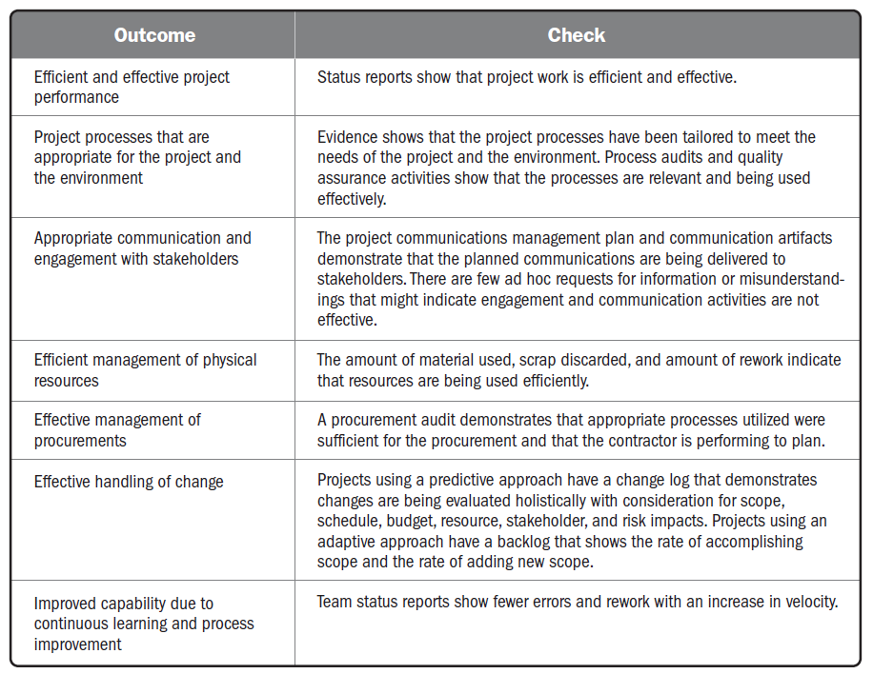

Slide 162
Delivery Performance Domain

Slide 163
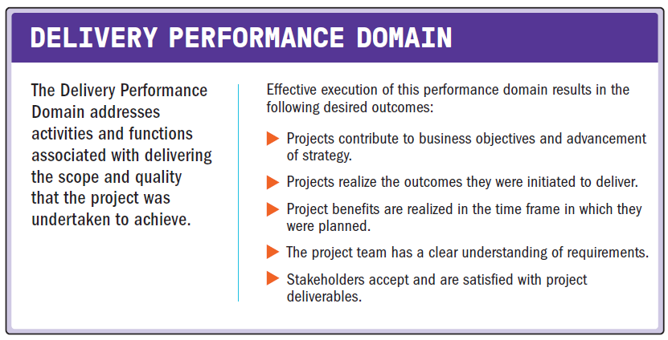
Delivery Performance Domain

Slide 164
Delivery Performance Domain
The following definitions are relevant to the Delivery Performance Domain:
Requirement.
A condition or capability that is necessary to be present in a product, service, or result to satisfy a business need.
Work Breakdown Structure (WBS).
A hierarchical decomposition of the total scope of work to be carried out by the project team to accomplish the project objectives and create the required deliverables.

Slide 165
Delivery Performance Domain
The following definitions are relevant to the Delivery Performance Domain:
Definition of Done (DoD).
A checklist of all the criteria required to be met so that a deliverable can be considered ready for customer use.
Quality.
The degree to which a set of inherent characteristics fulfills requirements.
Cost of Quality (COQ).
All costs incurred over the life of the product by investment in preventing nonconformance to requirements, appraisal of the product or service for conformance to requirements, and failure to meet requirements.

Slide 166
Delivery of Value
Projects that use a development approach that supports releasing deliverables throughout the project life cycle can start delivering value to the business, customer, or other stakeholders during the project.
Projects that deliver the bulk of their deliverable at the end of the project life cycle generate value after the initial deployment.
Business value often continues to be captured long after the initial project has ended.
Frequently, longer product and program life cycles are used to measure the benefits and value contributed by earlier projects.

Slide 167
Delivery of Value
A business case document often provides the business justification and a projection of anticipated business value from a project.
The format of this business case varies based on the development approach and life cycle selected.
Examples include business case documents with detailed estimates of return on investment or a lean, start-up canvas that describes high-level elements such as the problem, solution, revenue streams, and cost structures.
These business documents demonstrate how the project outcomes align with the organization’s business objectives.
Project-authorizing documents attempt to quantify the project’s desired outcomes to allow for periodic measurement.
These documents may range from detailed, baselined plans or high-level roadmaps that provide an overview of the project life cycle, major releases, key deliverables, reviews, and other top-level information.

Slide 168
Deliverables
Deliverable refers to the interim or final product, service, or results from a project.
The deliverables enable the outcomes that the project was undertaken to create.
Deliverables reflect the stakeholder requirements, scope, and quality, along with the long-term impacts to profit, people, and the planet.

Slide 169
Deliverables
Requirements
Requirements elicitation
Evolving and discovering requirements
Managing requirements
Scope Definition
Scope decomposition
Completion of deliverables
Moving Targets of Completion
a “good enough for release” or “done” goal may be subject to change.
project goal being delivered or “done” is constantly moving.

Slide 170
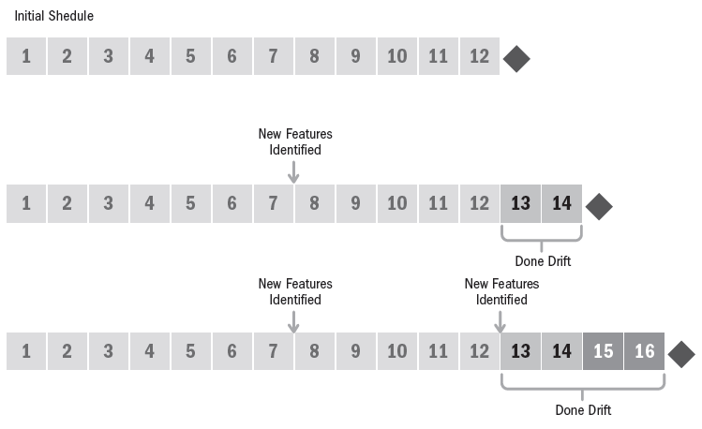
Scenario for Developing a Smart Watch

Slide 171
Quality
Delivery is more than just scope and requirements.
Scope and requirements focus on what needs to be delivered.
Quality focuses on the performance levels that are required to be met.
Quality requirements may be reflected in the completion criteria, definition of done, statement of work, or requirements documentation.

Slide 172
Quality
Much of the costs associated with quality are born by the sponsoring organization and are reflected in policies, procedures, and work processes.
For example, organizational policies that govern how work is performed and procedures that prescribe work processes are often part of the organization’s quality policy.
The cost of overhead, training, and process audit are born by the organization, though they are employed by the project.
Inherent in projects is balancing the quality needs of the processes and products with the costs associated with meeting those needs.

Slide 173
Cost of Quality
The cost of quality (COQ) methodology is used to find the appropriate balance for investing in quality prevention and appraisal to avoid defect or product failures.
Prevention
Appraisal
Internal Failure
External Failure

Slide 174
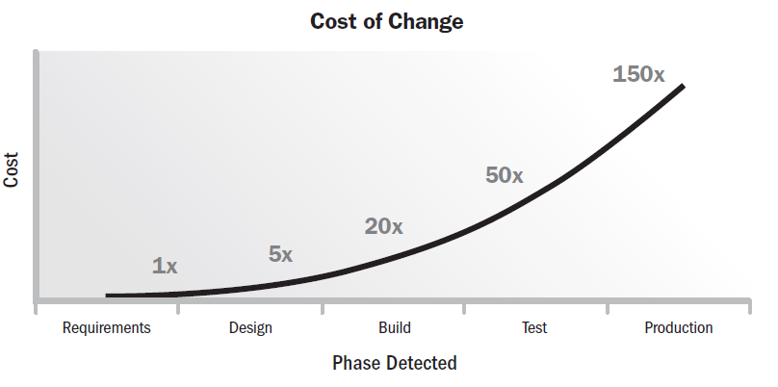
Cost of Change

Slide 175
Suboptimal Outcomes
All projects attempt to deliver outcomes, though some may fail to do so or may produce suboptimal outcomes.
The potential for suboptimal outcomes exists in every project.
In the case of a fully experimental project, the organization is attempting to achieve a breakthrough, such as the creation of a completely new technology, for example.
This requires deliberate investment in an uncertain outcome.
Companies that produce new medicines or compounds may experience several failures before finding a successful formula.
Some projects may fail to deliver outcomes because the market opportunity has passed or competitors were first to market with their offering.
Effective project management can minimize negative outcomes, but such possibilities are part of the uncertainty of attempting to produce a unique deliverable.

Slide 176
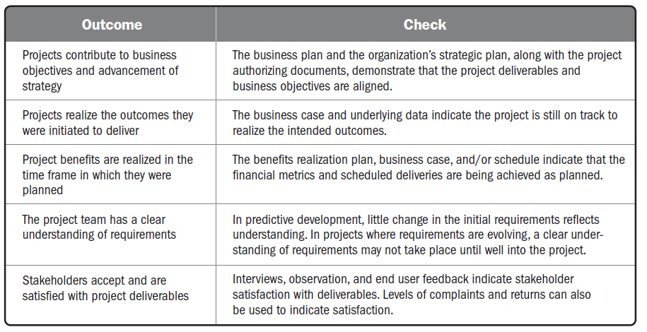
Checking Outcomes—Delivery Performance Domain

Slide 177
Measurement Performance Domain

Slide 178
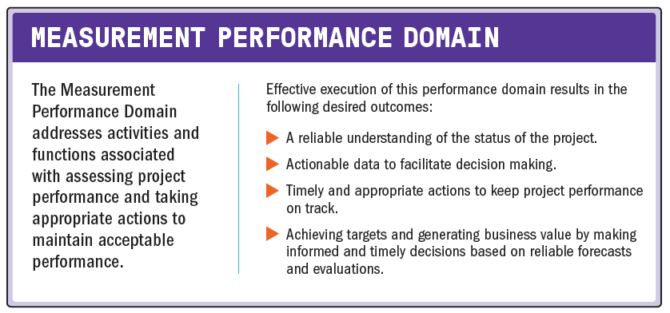
Measurement Performance Domain

Slide 179
Measurement Performance Domain
The following definitions are relevant to the Measurement Performance Domain:
Metric
A description of a project or product attribute and how to measure it.
Baseline
The approved version of a work product used as a basis for comparison to actual results.
Dashboard
A set of charts and graphs showing progress or performance against important measures of the project.

Slide 180
Measurement Performance Domain
Measures are used for multiple reasons, including:
Evaluating performance compared to plan;
Tracking the utilization of resources, work completed, budget expended, etc.;
Demonstrating accountability;
Providing information to stakeholders;
Assessing whether project deliverables are on track to deliver planned benefits;
Focusing conversations about trade-offs, threats, opportunities, and options; and
Ensuring the project deliverables will meet customer acceptance criteria.

Slide 181
Measurement Performance Domain
The value of measurements is not in the collection and dissemination of the data, but rather in the conversations about how to use the data to take appropriate action.
Therefore, while much of this performance domain addresses various types of measurements that can be captured, use of the measures occurs within the context of activities in other performance domains, such as project team and stakeholder discussions, coordinating project work, and so forth.

Slide 182
Establishing Effective Measures
It helps to ensure the right things are measured and reported to stakeholders.
Effective measures allow for tracking, evaluating, and reporting information that can communicate project status, help improve project performance, and reduce the likelihood of performance deterioration.

Slide 183
Establishing Effective Measures
Key Performance Indicators (KPIs)
Leading indicators
predict changes or trends in the project
Lagging indicators
measure project deliverables or events
They provide information after the fact

Slide 184
Establishing Effective Measures
Effective Metrics
Measuring takes time and effort, which could otherwise be spent on other productive work; therefore, project teams should only measure what is relevant and should ensure that the metrics are useful.
Characteristics of effective metrics (or SMART criteria) include:
Specific
Meaningful
Achievable
Relevant
Timely

Slide 185
What to Measure
What is measured, the parameters, and the measurement method depend on the project objectives, the intended outcomes, and the environment in which the project takes place.
Common categories of metrics include:
Deliverable metrics,
Delivery,
Baseline performance,
Resources,
Business value,
Stakeholders, and
Forecasts.

Slide 186
What to Measure
Deliverable metrics
Information on errors or defects, Measures of performance, Technical performance measures
Delivery
Work in progress, Lead time, Cycle time, Process efficiency
Baseline performance
Start and finish dates, Effort and duration, Schedule variance

Slide 187
What to Measure
Resources
Planned resource utilization compared to actual resource utilization, Planned resource cost compared to actual resource cost
Business value
Cost-benefit ratio, Return on investment (ROI), Net present value (NPV)
Stakeholders
Net Promoter Score (NPS), Mood chart, Morale, Turnover
Forecasts
Estimate to complete (ETC), Estimate at completion (EAC), Variance at completion (VAC)

Slide 188
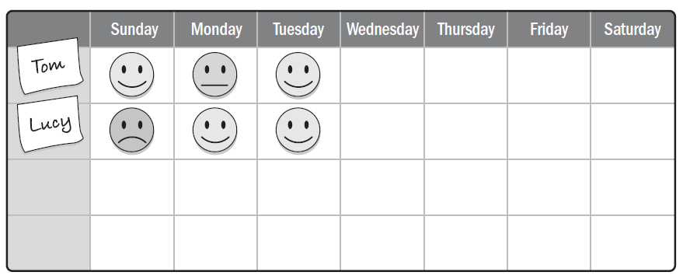
Mood Board

Slide 189
Presenting Information
Dashboards
Information Radiators
Visual Controls

Slide 190
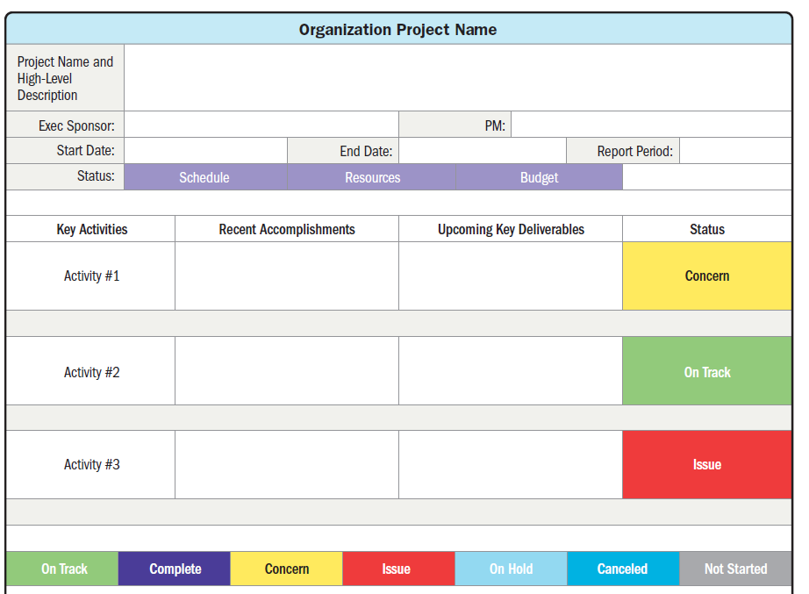
Presenting Information
Dashboards

Slide 191
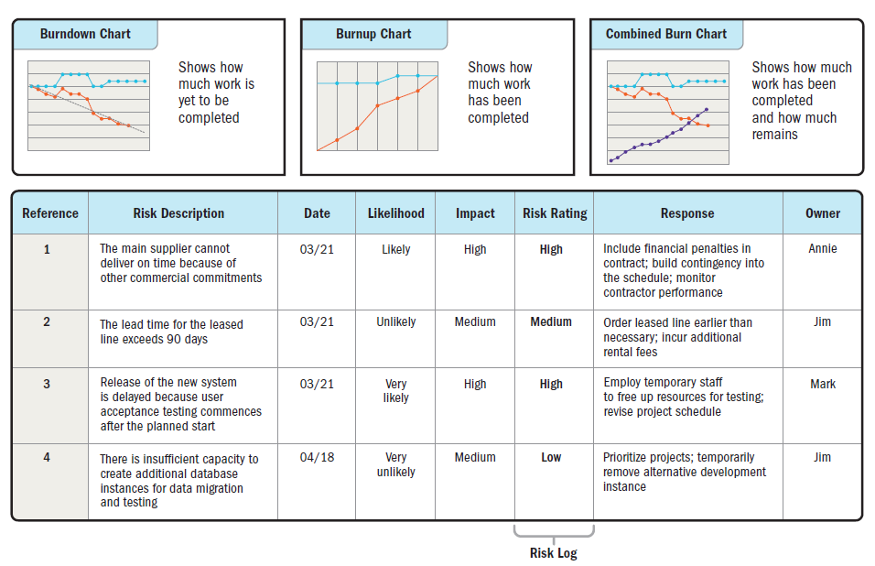
Presenting Information
Information Radiators

Slide 192
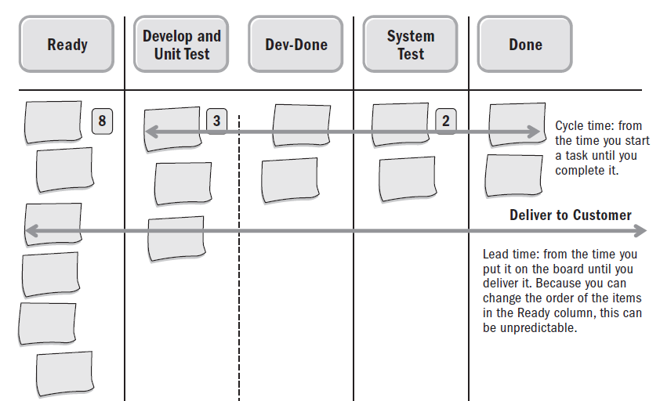
Presenting Information
Visual Controls
Task boards
Burn charts
Other types of charts

Slide 193
Measurement Pitfalls
Hawthorne effect
Vanity metric
Demoralization
Misusing the metrics
Confirmation bias
Correlation versus causation

Slide 194
Growing and Improving
The intent in measuring and displaying data is to learn and improve. To optimize project performance and efficiency, only measure and report information that will:
Allow the project team to learn,
Facilitate a decision,
Improve some aspect of the product or project performance,
Help avoid an issue, and
Prevent performance deterioration.

Slide 195
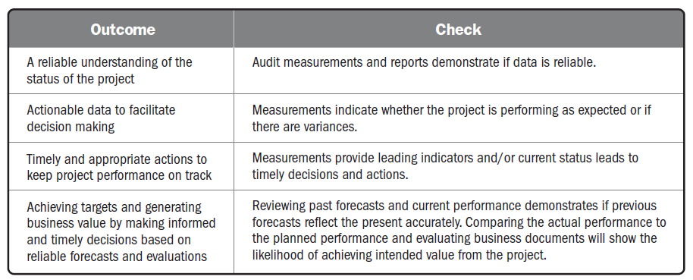
Checking Outcomes—Measurement Performance Domain

Slide 196
Uncertainty Performance Domain

Slide 197
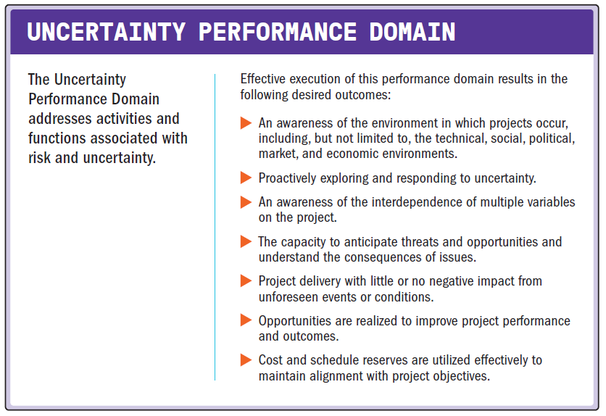
Uncertainty Performance Domain

Slide 198
Uncertainty Performance Domain
The following definitions are relevant to the Uncertainty Performance Domain:
Uncertainty
A lack of understanding and awareness of issues, events, paths to follow, or solutions to pursue.
Ambiguity
A state of being unclear, having difficulty in identifying the cause of events, or having multiple options from which to choose.
Complexity
A characteristic of a program or project or its environment that is difficult to manage due to human behavior, system behavior, and ambiguity.
Volatility
The possibility for rapid and unpredictable change.
Risk
An uncertain event or condition that, if it occurs, has a positive or negative effect on one or more project objectives.

Slide 199
Uncertainty Performance Domain
Uncertainty in the broadest sense is a state of not knowing or unpredictability.
There are many nuances to uncertainty, such as:
Risk associated with not knowing future events,
Ambiguity associated with not being aware of current or future conditions, and
Complexity associated with dynamic systems having unpredictable outcomes.

Slide 200
Uncertainty Performance Domain
Successfully navigating uncertainty begins with understanding the larger environment within which the project is operating.
Aspects of the environment that contribute to project uncertainty include, but are not limited to:
Economic factors such as volatility in prices, availability of resources, ability to borrow funds, and inflation/deflation;
Technical considerations such as new or emerging technology, complexity associated with systems, and interfaces;
Legal or legislative constraints or requirements;
Physical environment as it pertains to safety, weather, and working conditions;
Ambiguity associated with current or future conditions;
Social and market influences shaped by opinion and media; and,
Political influences, either external or internal to the organization.

Slide 201
General Uncertainty
There are several options for responding to uncertainty
Gather information
Prepare for multiple outcomes
Set-based design
Build in resilience

Slide 202
Ambiguity
There are two categories of ambiguity:
Conceptual ambiguity
The lack of effective understanding—occurs when people use similar terms or arguments in different ways.
For example, the statement, “The schedule was reported on track last week,” is not clear.
It isn’t clear whether the schedule was on track last week or whether it was reported on last week.
Situational ambiguity
Surfaces when more than one outcome is possible.
Having multiple options to solve a problem is a form of situational ambiguity.

Slide 203
Complexity
Complexity is a characteristic of a program, project, or its environment, which is difficult to manage due to human behavior, system behavior, or ambiguity.
Complexity exists when there are many interconnected influences that behave and interact in diverse ways.

Slide 204
Complexity
In complex environments, it is not uncommon to see an aggregation of individual elements leading to unforeseen or unintended outcomes.
The effect of complexity is that there is no way of making accurate predictions about the likelihood of any potential outcome or even of knowing what outcomes might emerge.
There are numerous ways to work with complexity; some of them are systems-based, some entail reframing, and others are based on process.

Slide 205
Systems-Based Complexity
Examples of working with complexity that is systems based include:
Decoupling
Disconnecting parts of the system to both simplify the system and reduce the number of connected variables.
Determining how a piece of a system works on its own reduces the overall size of the problem.
Simulation
There may be similar though unrelated scenarios that can be used to simulate components of a system.
A project to build a new airport that includes an area with shopping and restaurants can learn about consumer buying habits by seeking out analogous information on shopping malls and entertainment establishments.

Slide 206
Reframing Complexity
Examples of working with complexity that entail reframing are:
Diversity
Complex systems require viewing the system from diverse perspectives.
This can include brainstorming with the project team to open up divergent ways of seeing the system.
It can also include Delphi-like processes to move from divergent to convergent thinking.
Balance
Balancing the type of data used rather than only using forecasting data or data that report on the past or lagging indicators provides a broader perspective.
This can include using elements whose variations are likely to counteract each other's potential negative effects.

Slide 207
Process-Based Complexity
Examples of working with complexity that is process based include:
Iterate
Build iteratively or incrementally.
Add features one at a time. After each iteration, identify what worked, what did not work, customer reaction, and what the project team learned.
Engage
Build in opportunities to get stakeholder engagement.
This reduces the number of assumptions and builds learning and engagement into the process.
Fail safe
For elements of a system that are critical, build in redundancy or elements that can provide a graceful degradation of functionality in the event of a critical component failure.

Slide 208
Volatility
Volatility exists in an environment that is subject to rapid and unpredictable change.
Volatility can occur when there are ongoing fluctuations in available skill sets or materials.
Volatility usually impacts cost and schedule.

Slide 209
Volatility
Alternatives analysis and use of cost or schedule reserve address volatility.
Alternatives analysis
Finding and evaluating alternatives, such as looking at different ways to meet an objective, such as using a different mix of skills, resequencing work, or outsourcing work
Reserve
Cost reserve can be used to cover budget overruns due to price volatility.

Slide 210
Risk
Risks are an aspect of uncertainty.
A risk is an uncertain event or condition that, if it occurs, has a positive or negative effect on one or more project objectives.
Negative risks are called threats, and positive risks are called opportunities.
All projects have risks since they are unique undertakings with varying degrees of uncertainty.

Slide 211
Risk
Overall risk is often a function of complexity, ambiguity, and volatility. Responses to overall project risk are the same as for individual threats and opportunities, though responses are applied to the overall project rather than to a specific event.
If the overall risk on the project is too high, the organization may choose to cancel the project.

Slide 212
Risk (Threat)
A threat is an event or condition that, if it occurs, has a negative impact on one or more objectives.
Five alternative strategies may be considered for dealing with threats, as follows:
Avoid
Escalate
Transfer
Mitigate
Accept

Slide 213
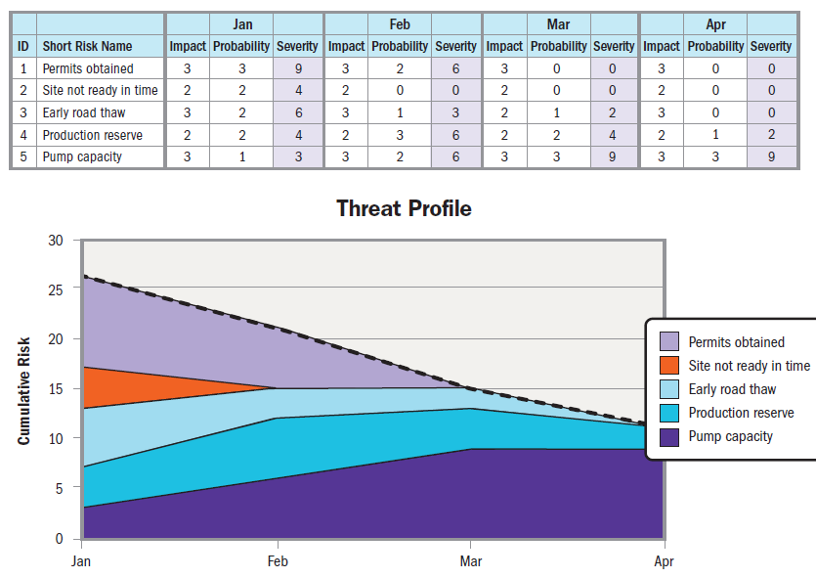
Risk Reduction over Time

Slide 214
Risk (Opportunities)
An opportunity is an event or condition that, if it occurs, has a positive impact on one or more project objectives.
An example of an opportunity could be a time and materials-based subcontractor who finishes work early, resulting in lower costs and schedule savings.
Five alternative strategies may be considered for dealing with opportunities, as follows:
Exploit
Escalate
Share
Enhance
Accept

Slide 215
Risk (Management and Contingency Reserve)
Reserve is an amount of time or budget set aside to account for handling risks.
Contingency reserve is set aside to address identified risks should they occur.
Management reserve is a budget category used for unknown events such as unplanned, in-scope work.

Slide 216
Risk (Risk Review)
Establishing a frequent rhythm or cadence of review and feedback sessions from a broad selection of stakeholders is helpful for navigating project risk and being proactive with risk responses.
Daily standup meetings can be used in any project and are a source for identifying potential threats and opportunities.
Reports of blockers or impediments could become threats if they continue to delay progress.
Likewise, reports of progress and breakthroughs might point toward opportunities to be further leveraged and shared.
Frequent demonstrations of increments of the product or service, interim designs, or proof of concepts can surface threats and opportunities.

Slide 217
